Slide 1

Stock Market Basics
How a Company “Goes Public” -- Mr. Yates

Slide 2

Some Financial Terms
Earnings per Share: The amount of profit to which each share is entitled.
Going Public: Slang for when a company is planning an IPO.
IPO: Short for Initial Public Offering. An IPO is when a company sells stock in itself for the first time.

Slide 3
Terms continued…
Market Cap: The amount of money you would have to pay if you bought ever share of stock in a company. (To calculate market cap, multiply the number of shares by the price per share.) Short for Market Capitalization.
Share: A share represents an investor's ownership in a "share" of the profits, losses, and assets of a company. It is created when a business carves itself into pieces and sells them to investors in exchange for cash.
Ticker Symbol: A short group of letters that represents a particular stock (e.g., "Coca Cola" is referred to as "KO".)
Underwriter: The financial institution or investment bank that is doing all of the paperwork and orchestrating a company's IPO.

Slide 4
Purpose of the Stock Market
Almost every large corporation started out as a small, mom-and-pop operation and through growth, became financial giants.
Wal-Mart, Dell Computer, and McDonald’s had combined profits of $10.34 billion this year.
Wal-Mart was originally a single-store business in Arkansas.

Slide 5

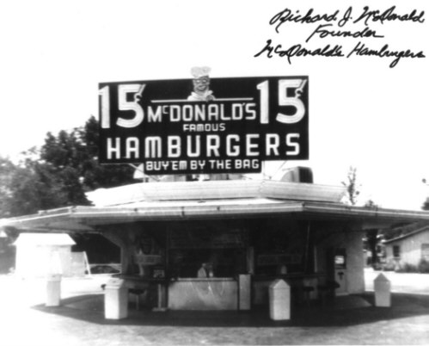
Stock Market
Dell computer began with Michael Dell selling computers out of his college dorm room.
McDonald’s was once a small restaurant no one had heard of.

Slide 6
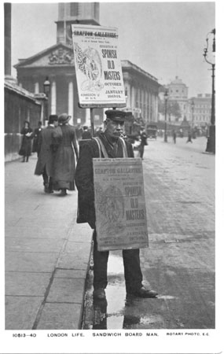
How did they grow?
How did these small companies grow from tiny, hometown enterprises to three of the largest businesses in the American economy?
They raised capital by selling stock in themselves.

Slide 7
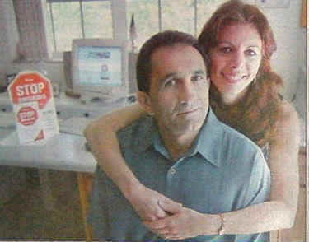
Example of a Company: New to Public
After getting married, a young couple decided to start a business. It would allow them to work for themselves, as well as arrange their hours around their family. Both husband and wife have always had a strong interest in furniture, so they decide to open a store in their hometown.
After borrowing money from the bank, they name their company “NW Furniture” and go into business.
The first few years, the company makes little profit because the earnings are plowed back into the store, buying additional inventory and adding onto the building to accommodate the increasing level of merchandise.

Slide 8
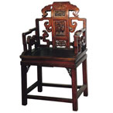
NW Furniture
Ten years later, the business has grown rapidly. The couple has managed to pay off the company’s debt, and profits are over $500,000 per year.
Convinced that NW Furniture could do as well in several larger, neighboring cities, the couple decides they want to open two new branches.
They research their options and find out it is going to cost over $4 million dollars to expand. Not wanting to borrow money and be strapped with interest payments again, they decide to sell stock in the company.

Slide 9
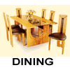
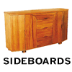
NW Furniture’s Value
The company approaches an “underwriter”, such as Goldman Sachs or JP Morgan, who determines the value of the business. As mentioned before, NW Furniture earns $500,000 after-tax profit each year.
It also has a book value of $3 million [the value of the land, building, inventory, etc. subtracted by the company’s debt] The underwriter researches and discovers the average furniture stock is trading at 20 times earnings.

Slide 10

NW Furniture’s “Book Value”
What does this mean? Simply, you would multiply the earnings of $500,000 by 20. In NW Furniture’s case, the answer is $10 million.
Add book value, and you arrive at $13 million.
This means, in the underwriter’s opinion, NW Furniture, is worth $13 Million.

Slide 11

So how much are they willing to give up?
Our young couple, now in their 30’s, must decide how much of the company they are willing to sell.
Right now, they own 100% of the business.

Slide 12
Giving it up…
The more they sell, the more cash they’ll raise, but they will also be giving up a larger part of their ownership.
As the company grows, that ownership will be worth more, so a wise entrepreneur would not sell more than he or she had to.

Slide 13
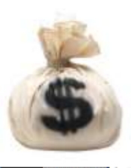
NW Furniture Goes Public!
After discussing it, the couple decides to keep 60% of the company and sell the other 40% to the public as stock.
[This means that they will keep $7.8 million worth of the business. Because they own a majority of the stock, they will still be in control of the store.]
The other 40% they sold to the public is worth $5.2 million.
The underwriters find investors who are willing to buy the stock, and give a check for $5.2 million to the couple.

Slide 14

So now they have cash to expand.
Although they own less of the company, their stake will hopefully grow faster now that they have the means to expand rapidly.
Using the money from their public offering, NW Furniture successfully opens the two new stores and have $1.2 million in cash left over.
[remember it was going to cost $4 million for the new stores].

Slide 15
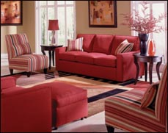
Expanding…
Business is even better in the new branches, which are in more populated cities.
The two new stores both make around $800,000 a year in profit each, with the old store still making the same $500,000.
Between the three stores, NW Furniture now makes an annual profit of $2.1 million dollars.

Slide 16

So what are they worth now?
This is great news because, although they don’t have the freedom to simply close shop anymore, the business is now valued at $51 million dollars
[multiply the new earnings of $2.1 million per year by 20 and add the book value of $9 million; there are three stores now, instead of one].
The couple’s 60% stake is worth $30.6 million dollars.

Slide 17

Ahh, that’s how it works!
With this example, it’s easy to see how small businesses seem to explode in value when they go public.
The original owners of the company are, in a sense, wealthier overnight.
Before, the amount they could take out of the business was limited to the profit.
Now, they are free to sell their shares in the company at any time, raising cash quickly.

